Slide 1
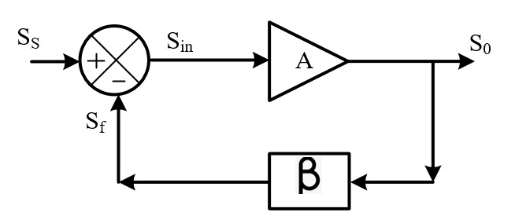
FEED BACK SYSTEM
Basic model of feedback amplifier consist of
Forward amplifier: The input signal to the forward amplifier is S_{in} and the output signal from the amplifier is S_{o} . The gain of the amplifier is A.
Feedback network: The input signal to the feedback network is S_{o} and the output signal from the feedback network is the feedback signal S_{f} . The gain of the feedback network is β.
Signal sampler: Signal sampler is taping the output signal for feedback.
Signal mixer: Signal mixer is mixing the feedback signal S_{f} with the primary input signal S_{s} to generate the input signal to the amplifier S_{in} . The mixer is multiplying the input signals with +1 or -1 and then mix it.
Types of Feedback system
Negative feedback system 2) Positive feedback system

Slide 2
Negative Feedback System
For a change at a point in the system/ circuit if the created effect coming back to the point through the feedback path negate the original change then the feedback system is called negative feedback system.
Assume S_{in} is increased. If A is positive S_{o} also increases. If β is positive S_{f} also increases. When the signal is going through the mixer, if it is negative the signal coming back to the input of the amplifier is in the opposite direction [negating the original change]. Hence it is called as the negative feedback system.
Based on the sign of mixer, A and βwe will get neagative feedback.

Slide 3
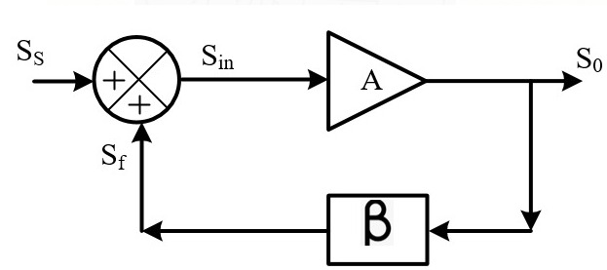
Positive Feedback System
For a change at a point in the system/circuit if the created effect coming back to the point through the feedback path aggravate the original change then the feedback system is called as positive feedback system.
Assume S_{in} is increased. If A is positive S_{o} also increases. If β is positive S_{f} also increases. When the signal is going through the mixer, if it is positive the signal coming back to the input of the amplifier is in the same direction or phase [aggravate the original change]. This is known as positive feedback system.
Based on the sign of mixer, A and βwe will get positive feedback system.

Slide 4
Parameters of negative Feedback system

Slide 5
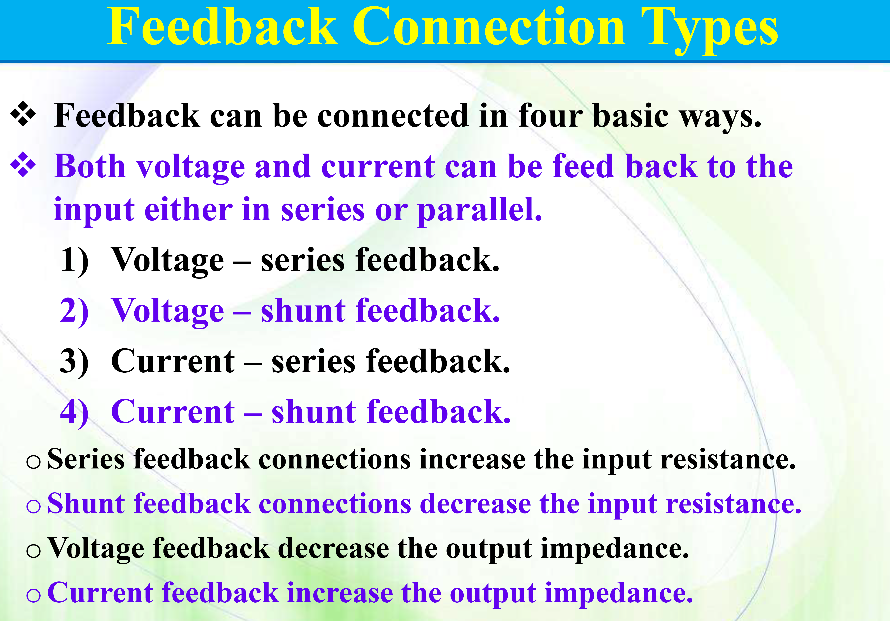

Slide 6
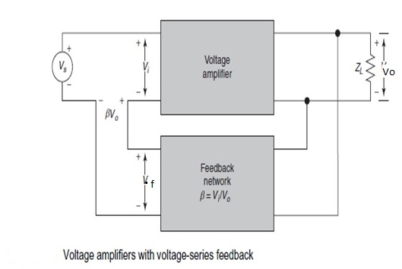
1) Voltage-series feedback:
The input signal is voltage and the output signal is voltage. Voltage is sampled at the output and feedback in the form of voltage at the input. Forward amplifier converts voltage to voltage. So the gain of the amplifier is voltage gain Av. The feedback path converts voltage to voltage and its gain is β.
The voltage gain with feedback is
The voltage gain with feedback reduces the gain Av by the factor (1+β Av). When β Av>>1,
The voltage gain is stabilized to

Slide 7
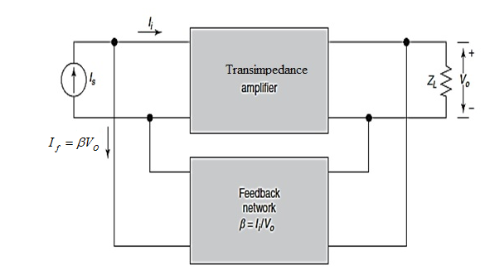
2) Voltage-Shunt Feedback
The input signal is current and the output signal is voltage. Voltage is sampled at the output and feedback in the form of current at the input. Forward amplifier converts current to voltage. So the gain of the amplifier is trans impedance Z_{m} . The feedback path converts voltage to current and its gain is β.
The trans impedance with feedback is
The gain with feedback reduces the gain by the factor ( ) . When >>1,
The trans impedance with feedback is stabilized to

Slide 8
3)Current-shunt feedback
The input signal is current and the output signal iscurrent. Current is sampled at the output and feedback in the form of current at the input. Forward amplifier converts current to current. So the gain of the amplifier is current gain A_{i}. The feedback path converts current to current and its gain is β.
The current gain with feedback
The current gain with feedback reduces the gain Av by the factor (1+β Av). When >>1,
The current gain with feedback is stabilized to

Slide 9
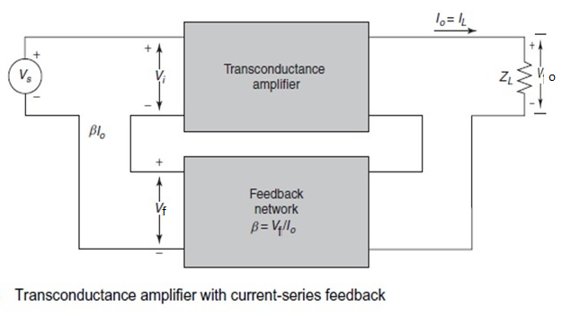
4) Current-Series Feedback:
The input signal is voltage and the output signal is current. Current is sampled at the output and feedback in the form of voltage at the input. Forward amplifier converts voltage to current. So the gain of the amplifier is trans conductance. The feedback path converts current to voltage and its gain is β.
The trans conductance with feedback
The gain with feedback reduces the gain by the factor ( ) . When >>1,
The trans conductance with feedback is stabilized to

Slide 10
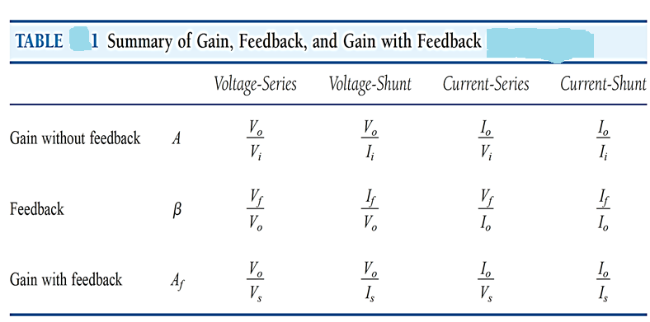
Summary

Slide 11
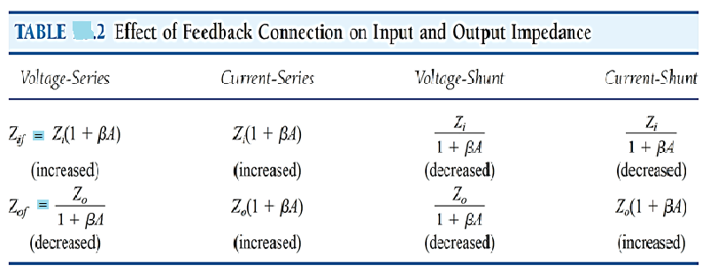
Summary of effects of negative feedback

Slide 12
Effect of negative feedback on frequency response
The gain of the forward amplifier is A.
The gain of the feedback amplifier is
The reduction in gain of the amplifier is
The bandwidth increases by the same factor
Hence the gain bandwidth product remain the same.
Unity gain frequency is remaining the same.

Slide 13
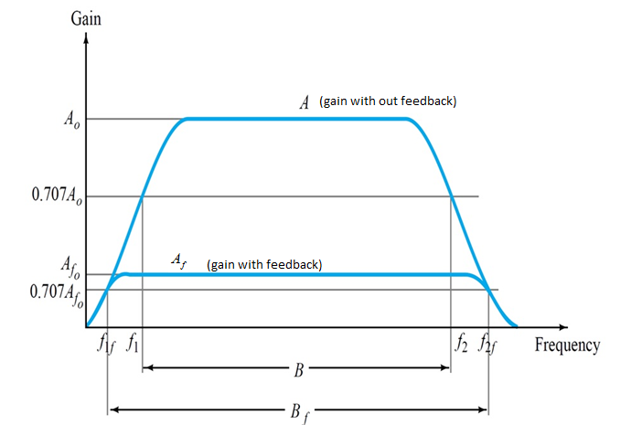
Frequency response of negative feedback amplifier

Slide 14
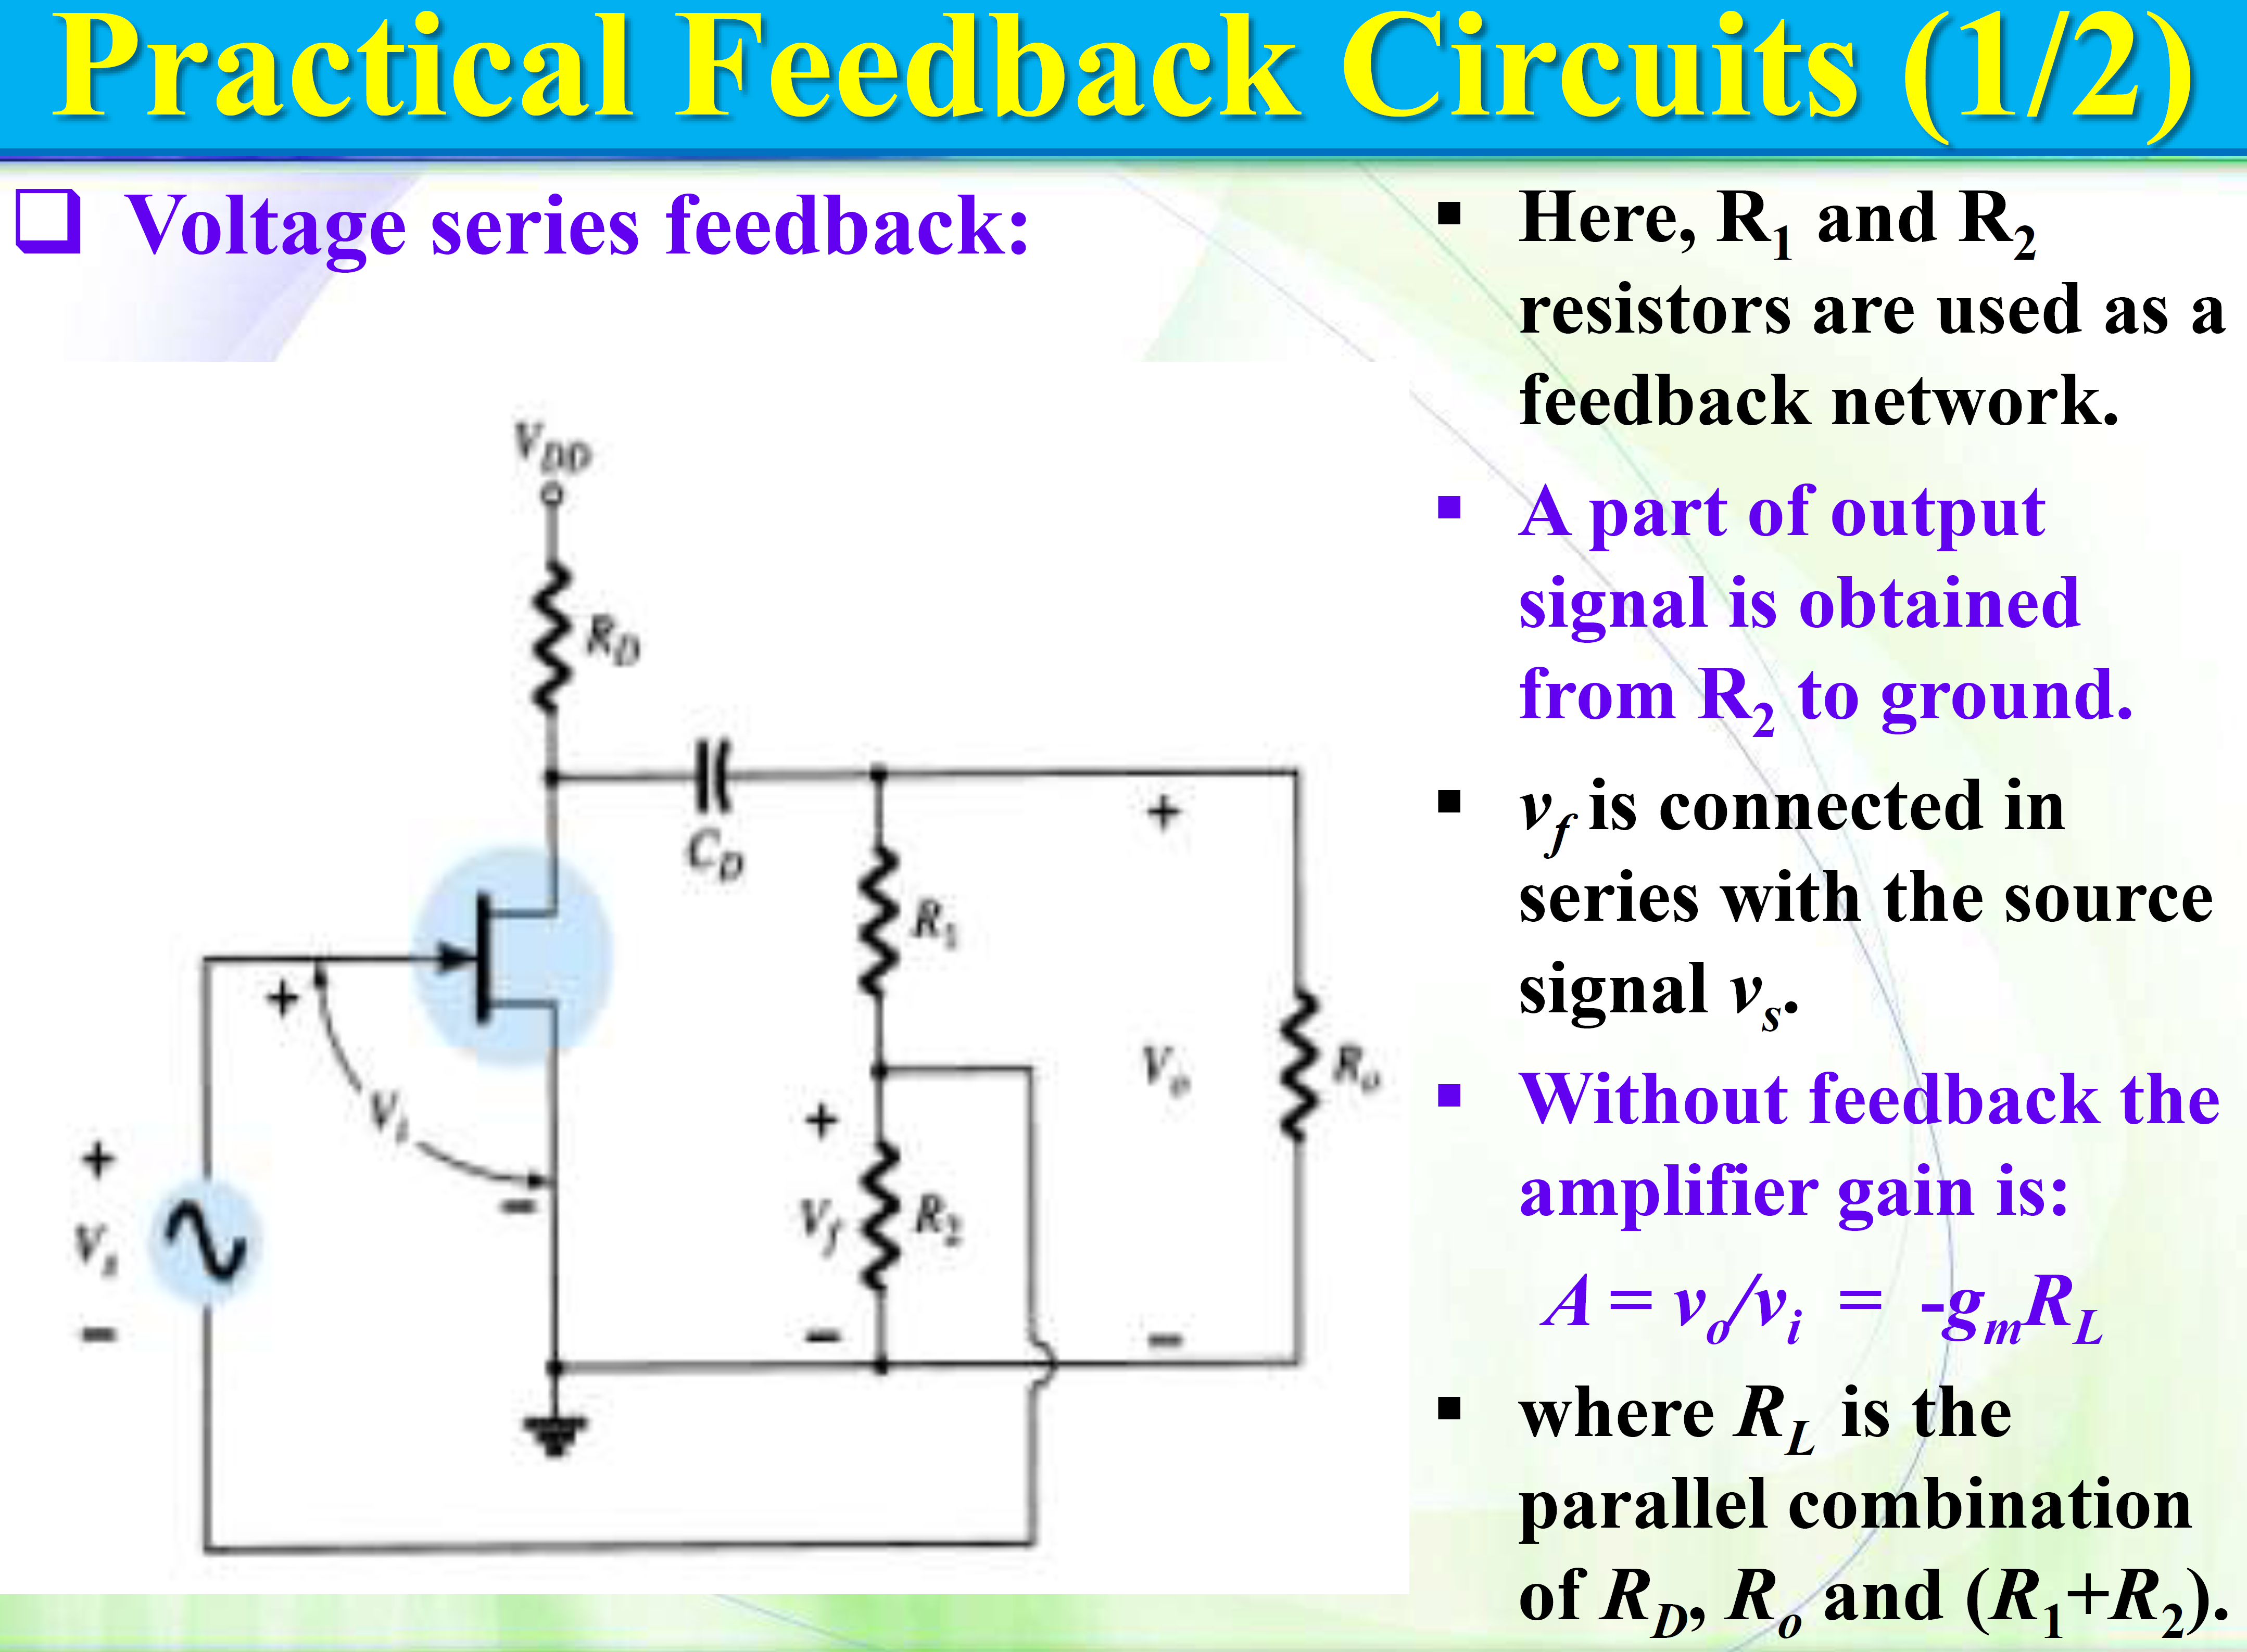

Slide 16
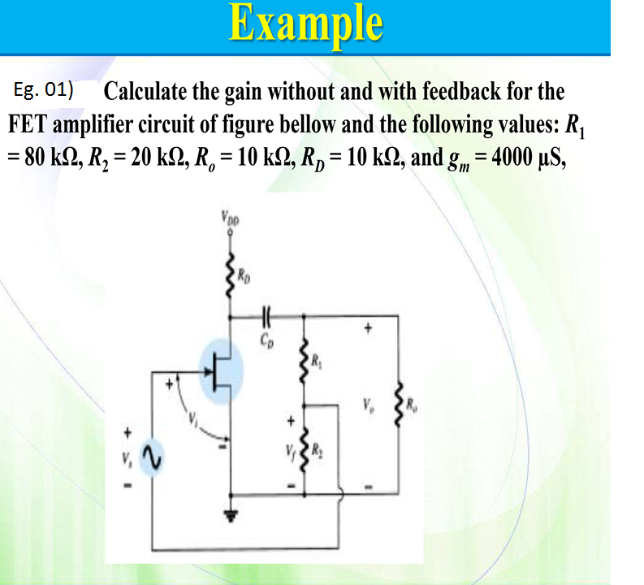

Slide 17
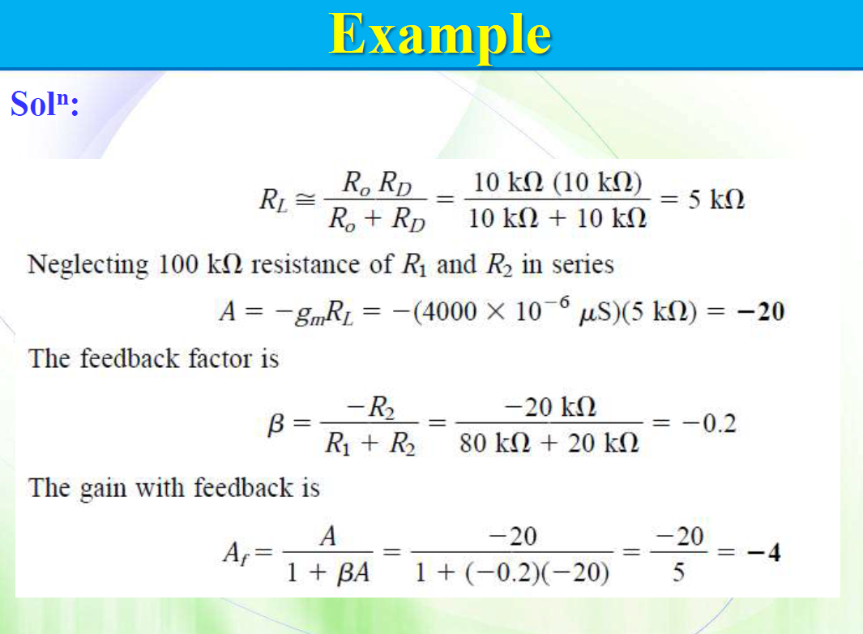

Slide 18
